Slide 1

Graph
Paul Rad, Ph.D.
Associate Professor
Cyber Analytics and AI
Information Systems and Cyber Security
College of Business School
210.872.7259

Slide 2
Outline
Graph Analytics
Path Analytics
Connectivity Analytics
Community Analytics
Centrality Analytics

Slide 3
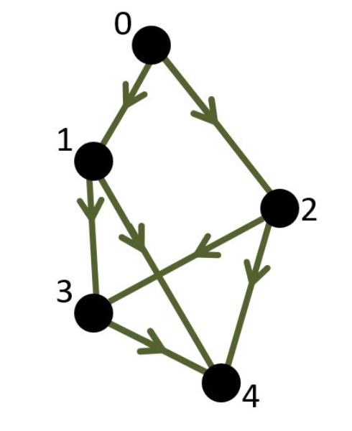
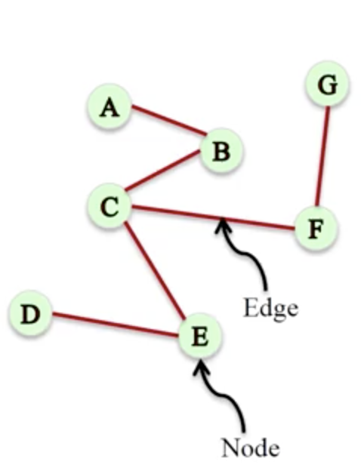
Graph Theory = Network Math Definition
Network = graph : A representation of connections among a set of objects. A graph is a set of nodes (vertices) joined by a set of lines or arrows (edge).
More formally, we define a graph G as an ordered pair G = (V,E) where
V is a set of vertices (nodes)
E is a set of edges (links).
Each edge is a pair of vertices. In other words, each element of E is a pair of elements of V.
Example: The picture above represents the following graph:
V = {1,2,3,4,5,6}
E = {{1,2},{1,5},{2,3},{2,5},{3,4},{4,5},{4,6}}
Directed/Weighted Graph
Directed Graph
Undirected Graph

Slide 4
Graph Analytics
Path Analytics
Connectivity Analytics
Centrality Analytics
Community Analytics

Slide 5
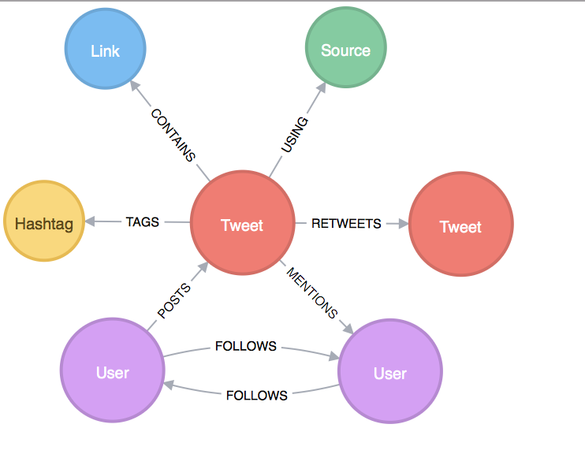
Graph of a Tweet
A real graph has more more information content
Different type of nodes
Question - Which of the following are the kinds of types, nodes in a tweet graph might have?
User
Media
Hashtag

Slide 6
Extended Graph Model
V: is a set of vertices (nodes)
E: is a set of edges (links).
TN: set of node types
f (TN → V): type assignment to nodes (labels)
AN: set of node attributes
TE: a set of edge types
g (TE→ E): type assignment to edges (labels)
AE: set of edge attributes
Node Schema = Properties (attributes) with Values
Edge Schema = Properties (attributes) with Values

Slide 7
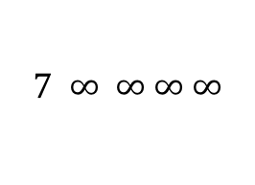
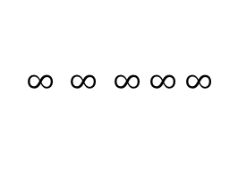
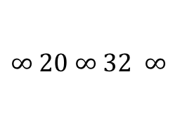
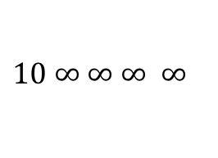
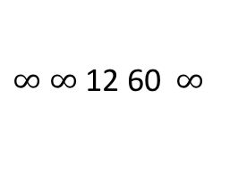
Edge Weight = an Edge Property
Distance in a road network
Strength of Connection in a personal network
Likelihood of interaction in a biological network
$∞$ $∞$ 12 60 $∞$
$10$ $∞$ $∞$ $∞$ $∞$
$∞ 20$ $∞$ $32$ $∞$
$$∞ ∞ ∞ ∞ ∞$$
$$7 ∞ ∞ ∞ ∞$$
0 1 0 0 1 0
1 0 1 0 1 0
0 1 0 1 0 0
0 0 1 0 1 1
1 1 0 1 0 0
0 0 0 1 0 0

Slide 8
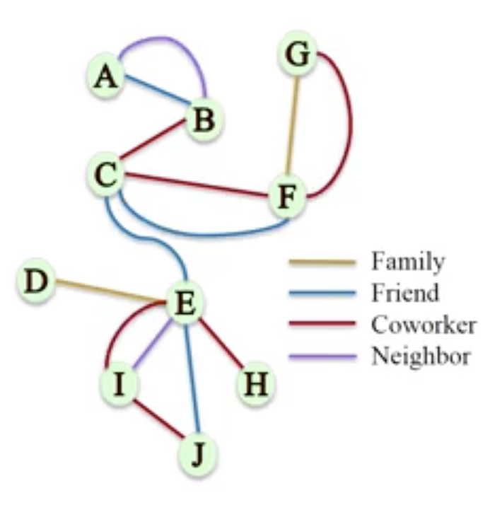
Multigraphs
A pair of nodes can have different types of relationships simultaneously
Multigraph: A network where multiple edges (parallel edges) can connect the same nodes
A loop in a graph is where ….
There is a way to get from node A to node B and back to node A
There is some (arbitrary length) path from a node back to itself, passing through other nodes
There is an edge from a node to itself

Slide 9
Path Analytics
Walk: an alternating sequence f vertices and edges over a graph.
H->F->G->C->F->E->B
Edges and nodes can be repeated
Path: A walk with no repeating node except possibly for the first and last
J->G->C->F->E->B
Constraining a walk
Cycle: a path of length n >= 3 whose start and end vertices are the same J->G->C->F->J
Acyclic: A walk with no cycle

Slide 10
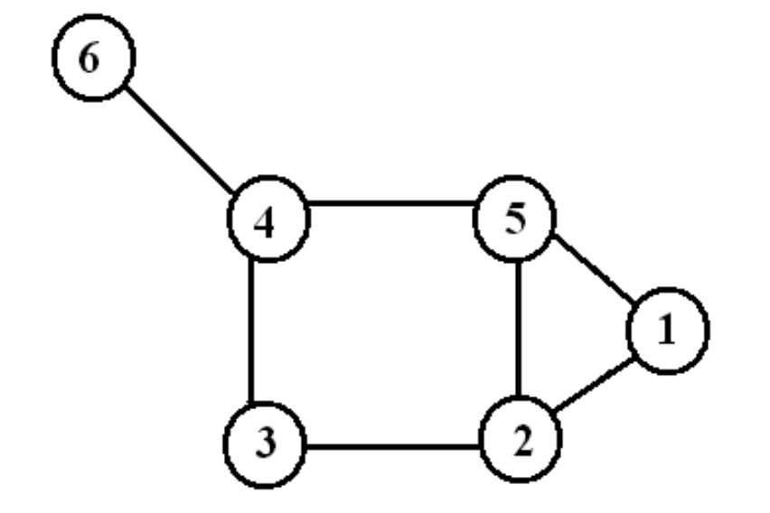
Path, Walk, Cycle
1,2,5,2,3,4 ---- Walk of length 5
1,2,3,4,6 ---- path of length 4
1,2,5,1 ---- 3-cycle
2,3,4,5,2 ---- 4-cycle

Slide 11
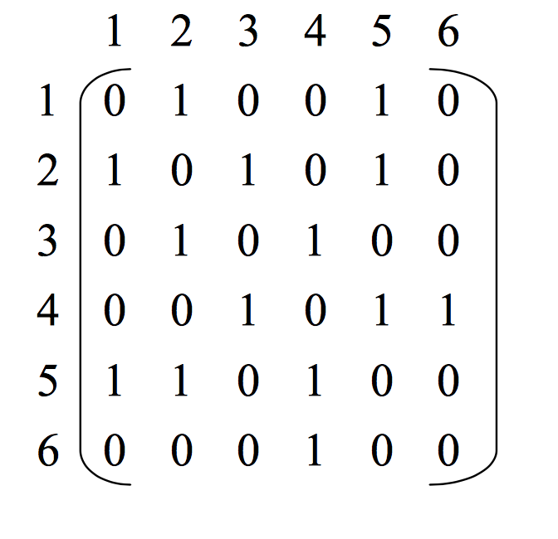
Adjacency Matrix
V x V
Boolean values (adjacent or not)
Or Edge Weights

Slide 12
Path Analytics
Trail: no edge can be repeated
Reachability: node u is reachable from node v if there is a path from v to u
B is reachable from J
J is not reachable from B

Slide 13
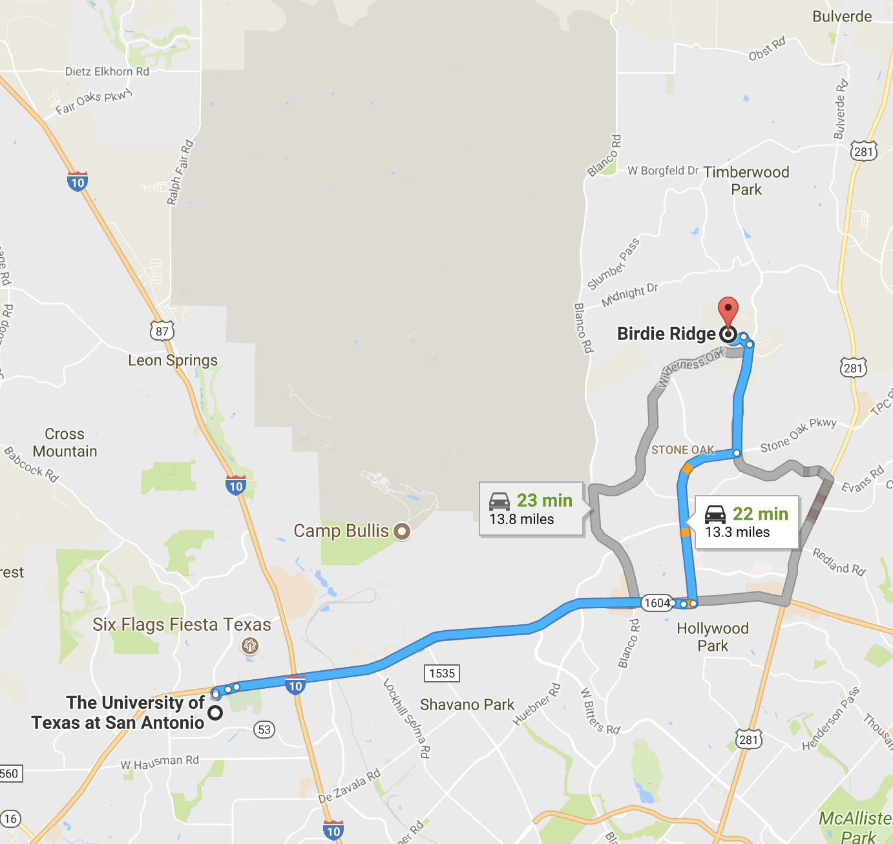
The Best Path
What is the “best” path to go from node u to node v?
Specification of “best” may include
Function to optimize
Nodes/edges to traverse
Nodes/edges to avoid
Preferences to satisfy

Slide 14
Shortest Path
Function of optimization (Simpler Problem)
Find least weight path from I to B
(Dijkstra’s Algorithm)

Slide 15
Graph Search (Breadth-first vs. Depth-first)

Slide 16
Shortest Path – Dijkstra’s Algorithm

Slide 17
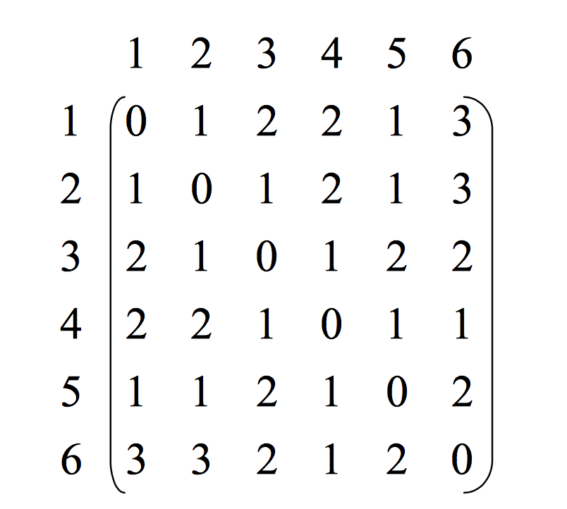
Distance Matrix
|V | x |V | matrix D = ( d ) such that dij is the topological distance between i and j.

Slide 18
Path Analytics
Find least weight path from I to B with constraints:
Nodes/edges to traverse
Nodes/edges to avoid
Example:
Avoid paths through E
Must go through J

Slide 19
Source 2

Slide 20
Graph Diameter
Diameter: the length of the “longest shortest path” between any two vertices (u,v). In other words, a graph's diameter is the largest number of vertices which must be traversed in order to travel from one vertex to another vertex.
To
From

Slide 21
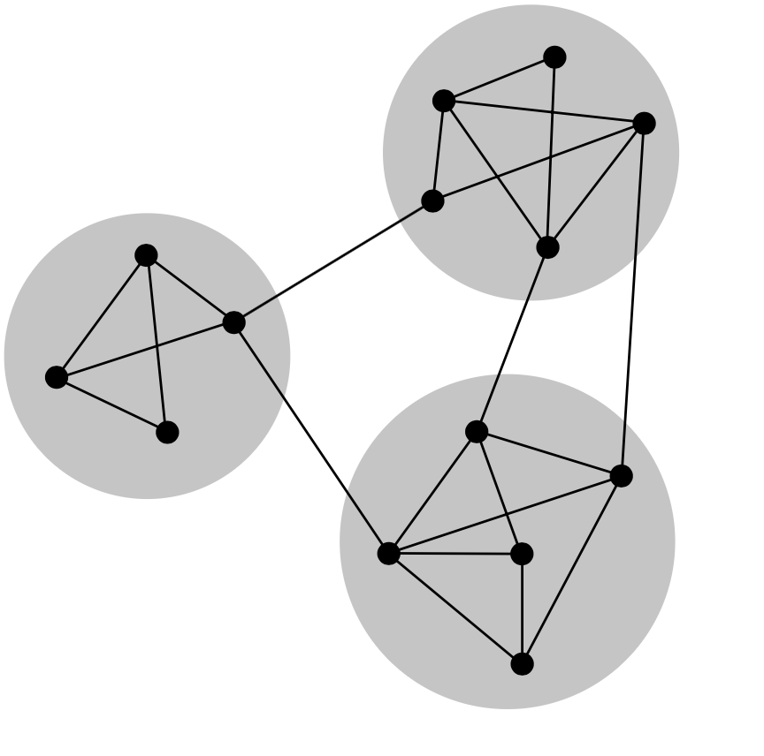
Why Graph Connectivity
Measuring Network Robustness
Estimate the connectedness of a network
Evaluate how much a structure is affected by an attack (Redundancy)
Graph Connectivity: Asks for the minimum number of elements (nodes or edges) that need to be removed to disconnect the remaining nodes from each other
Finding connected component of a graph
Strongly connected fragment(s) of a graph

Slide 22
Graph Connectivity Analysis
Connectedness: A graph is connected if it contains a directed path from u to v or a directed path from v to u for every vertex-pair (u,v)
For Directed Graphs:
Strongly connected: a directed path from every u to every v Weakly connected: connected after converting a directed graph to an undirected graph
Is this graph strongly or weakly connected?

Slide 23
Disconnecting a Connected Graph
Node Connectivity is 3

Slide 24
Disconnecting a Connected Graph
Edge Connectivity is 4

Slide 25
Network Robustness
If node v is reachable from node u originally, it should remain reachable even if the network is “attacked”
Attacked
• Node/edge removed
Degree of a node = Number of edges connected to it.
Degree of node F = 5
-- Higher degree node is makes it higher vulnerable
???
???

Slide 26
Is this network robust?
Robustness – assessed with respect to attacks Remove F (why F?)
Paths C→G, C→J, C→E, J→E, I→E disrupted
Which node should the attacker target next?

Slide 27
Indegree and Outdegree
For a vertex, the number of head ends adjacent to a vertex is called the indegree of the vertex and the number of tail ends adjacent to a vertex is its outdegree

Slide 28
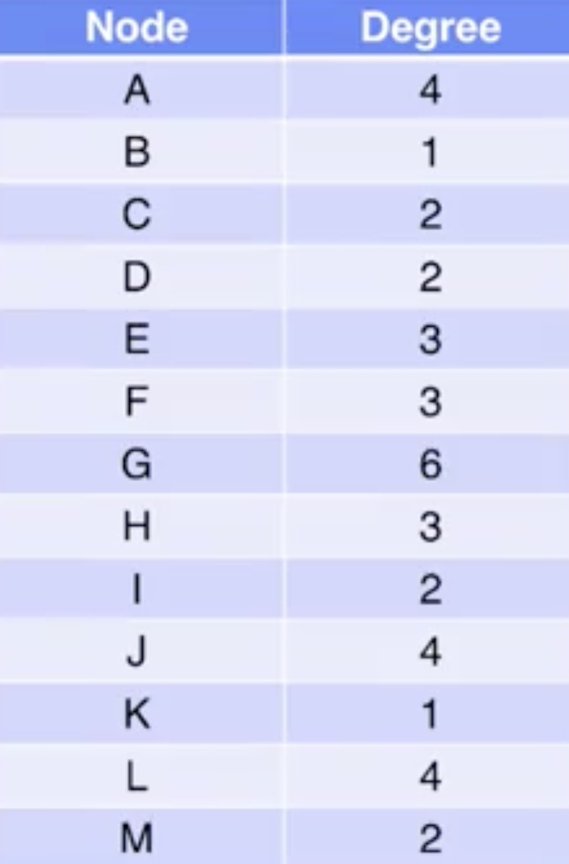
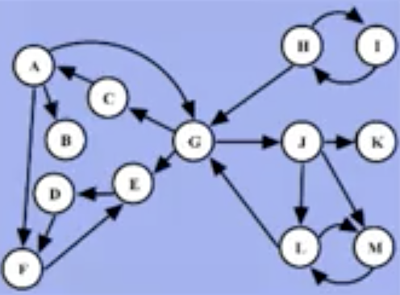
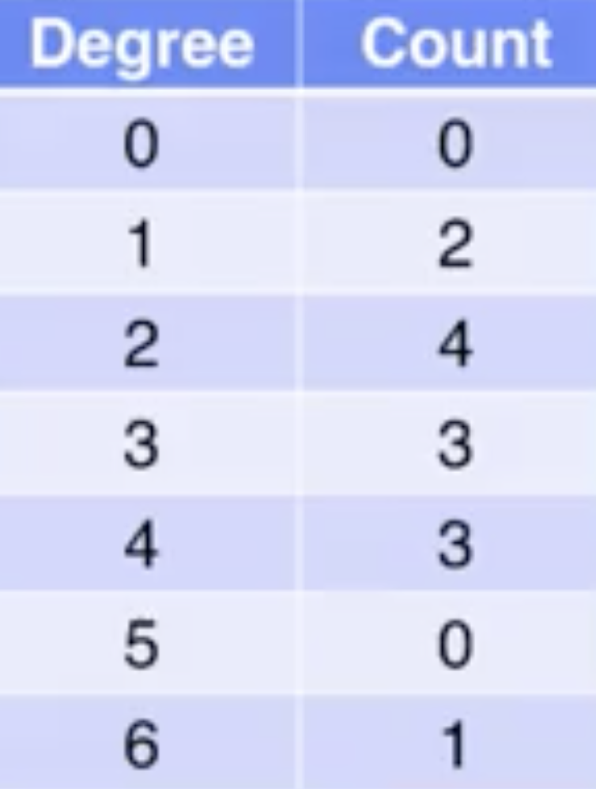
Node Degree and Histogram
Degree Table
Degree Histogram

Slide 29
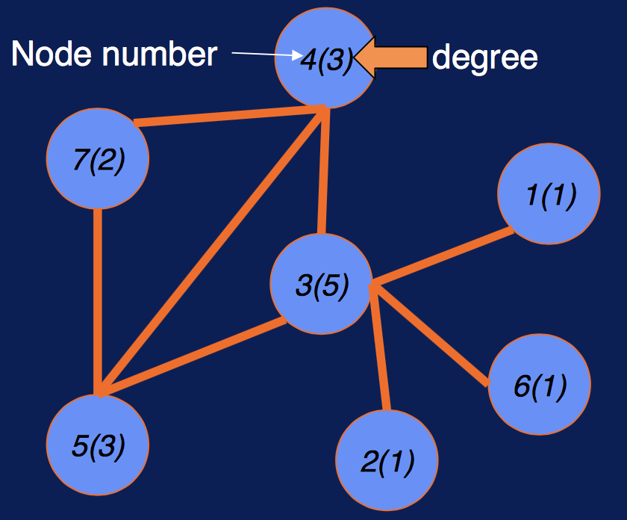
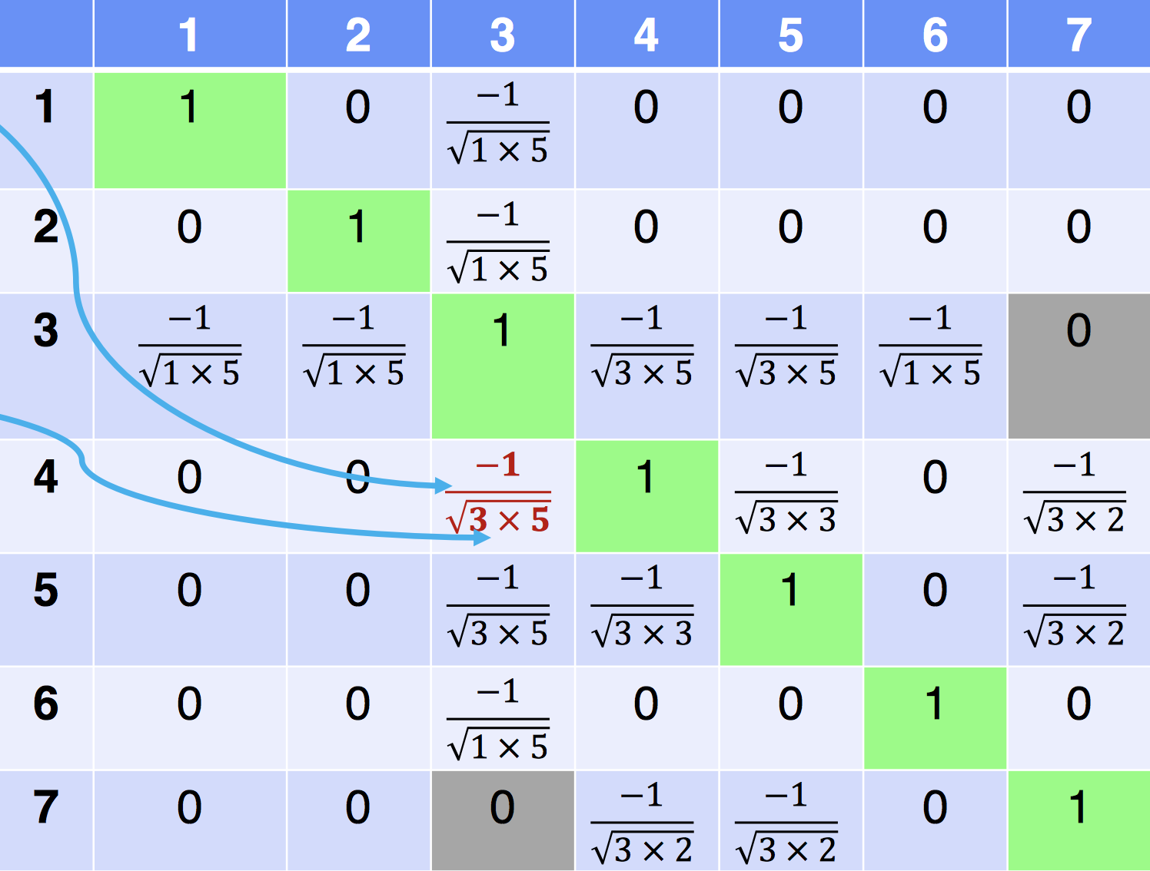
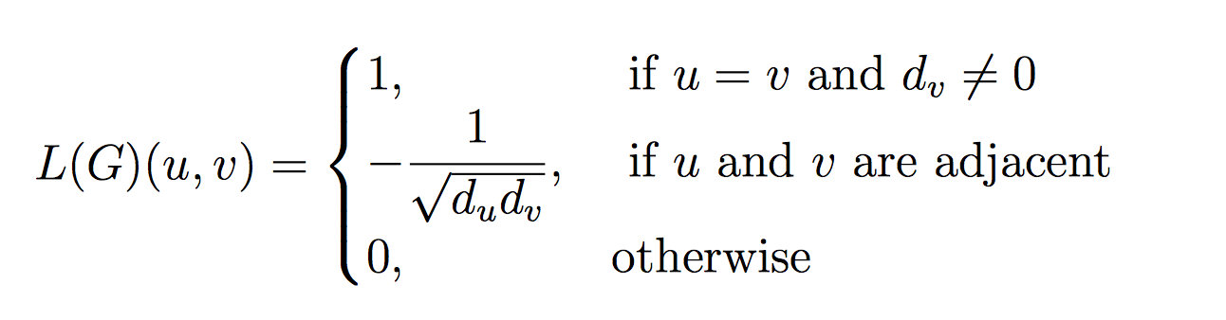
Weighted Spectral Distribution
Normalized Laplacian Matrix L – symmetric
The weighted spectral distribution (WSD) is a metric defined on the normalized Laplacian spectrum. It can be used for comparing complex networks with different sizes (number of nodes) and provides a sensitive discrimination of the structural robustness of complex networks.

